Slide 2
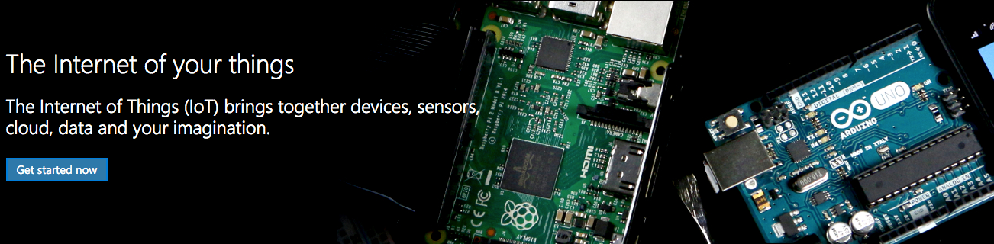
Welcome to IoT with Windows – The Internet of Your Things

Slide 3
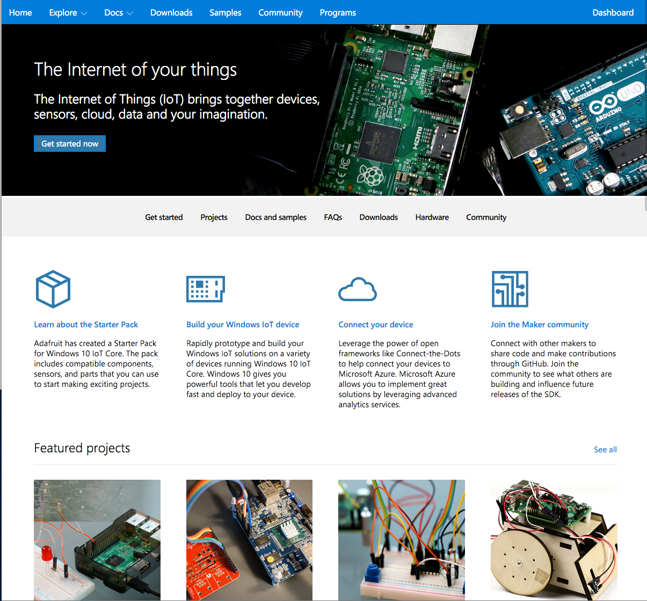
Where to start
Windowsondevices.com

Slide 4
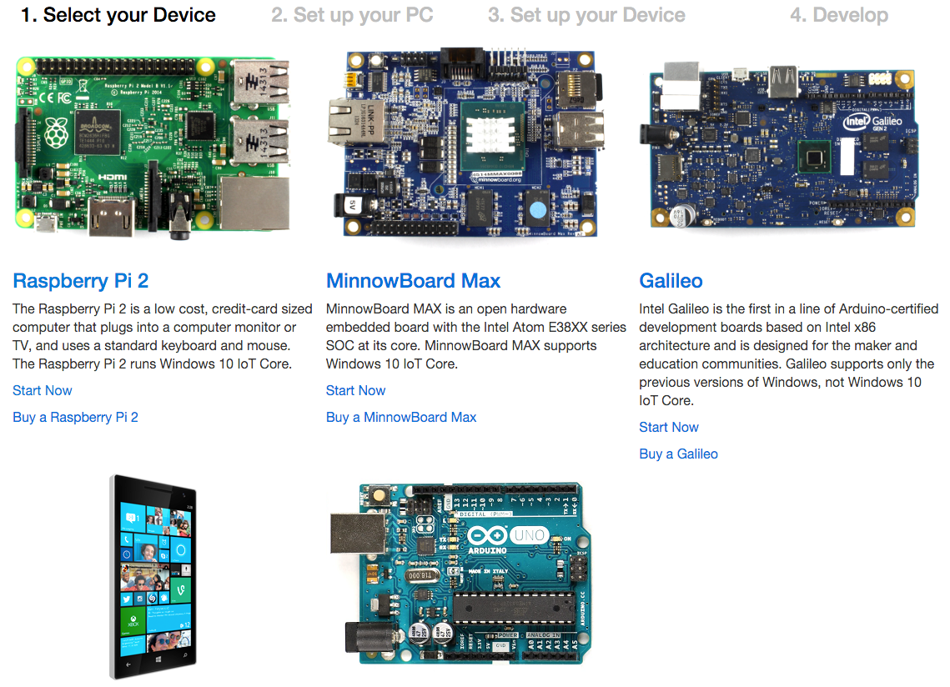
What you will need
A Raspberry Pi 2
Minnowboard Max
Maybe a Windows 10 Phone
Adruino
Windows 10 PC
VS.NET 2015 with IoT Extensions

Slide 5
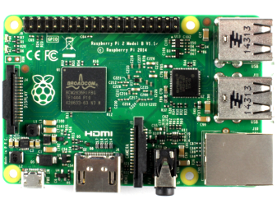
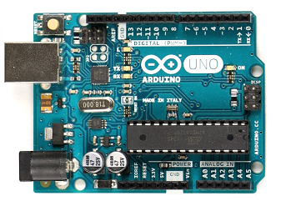
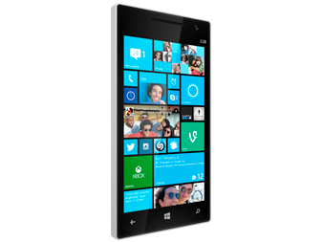
What we will look at
Raspberry Pi2
Windows Remote Arduino
Maybe the Photon (but its not Win IoT)

Slide 6
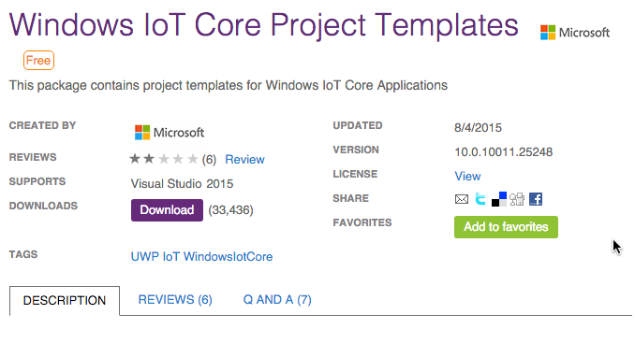
Getting started - Tools
http://ms-iot.github.io/content/en-US/win10/SetupPCRPI.htm
https://visualstudiogallery.msdn.microsoft.com/06507e74-41cf-47b2-b7fe-8a2624202d36

Slide 7
Configure a pi
8GB Min SD Card
Download the tools
Install on your card
Start the device

Slide 8
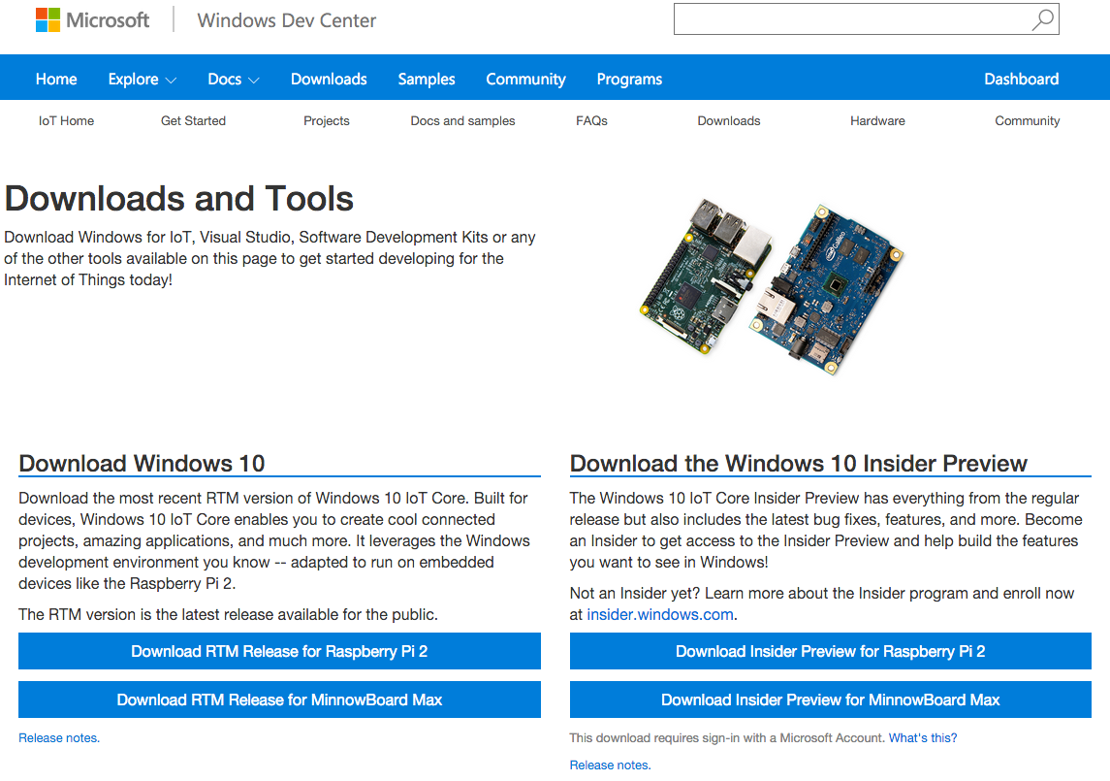
downloads
Get the tools here
http://ms-iot.github.io/content/en-US/Downloads.htm

Slide 9
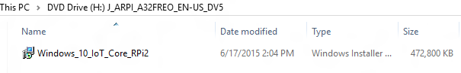
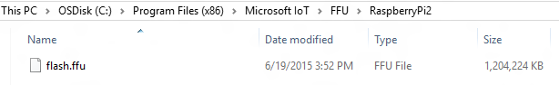
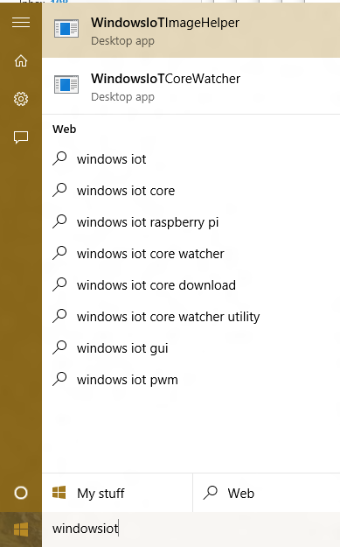
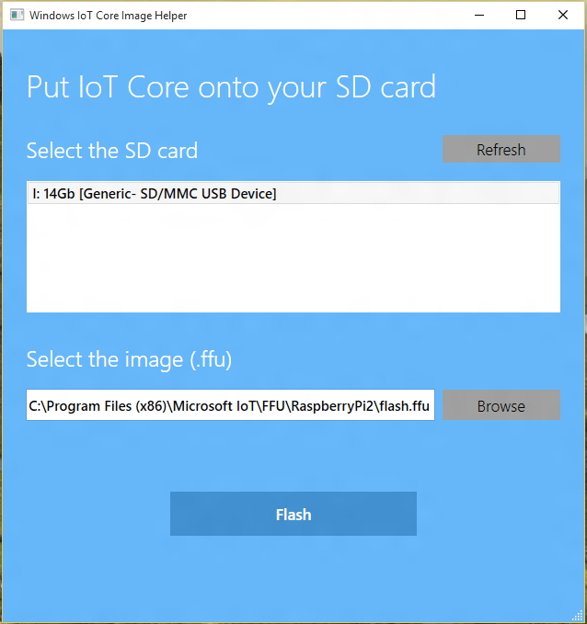
Installation
Go through all these steps

Slide 10
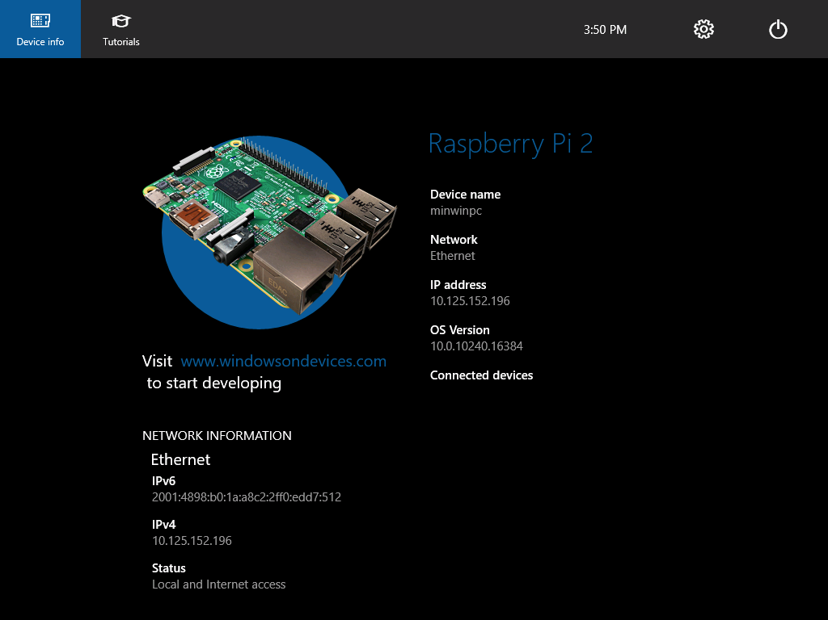
Boot up the pi

Slide 11
Wait! You need to do powershell stuff
Enter-PSSession -ComputerName <machine-name or IP Address> -Credential <machine-name or IP Address or localhost>\Administrator
Docs at http://ms-iot.github.io/content/en-US/win10/samples/PowerShell.htm
netstart WinRM
Set-Item WSMan:\localhost\Client\TrustedHosts –Value <machine name or ip>
Enter-PSSession –ComputerName <machine name or ip> -Credentials <machine>\Administrator
Password is p@ssw0rd
Net user Administrator [new password]

Slide 12
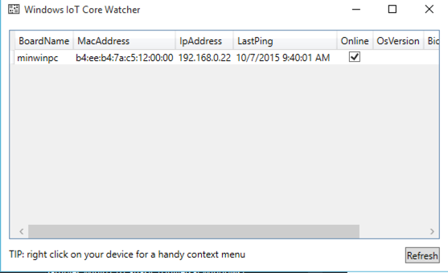
Locator
Communications relay between VS and the device

Slide 13
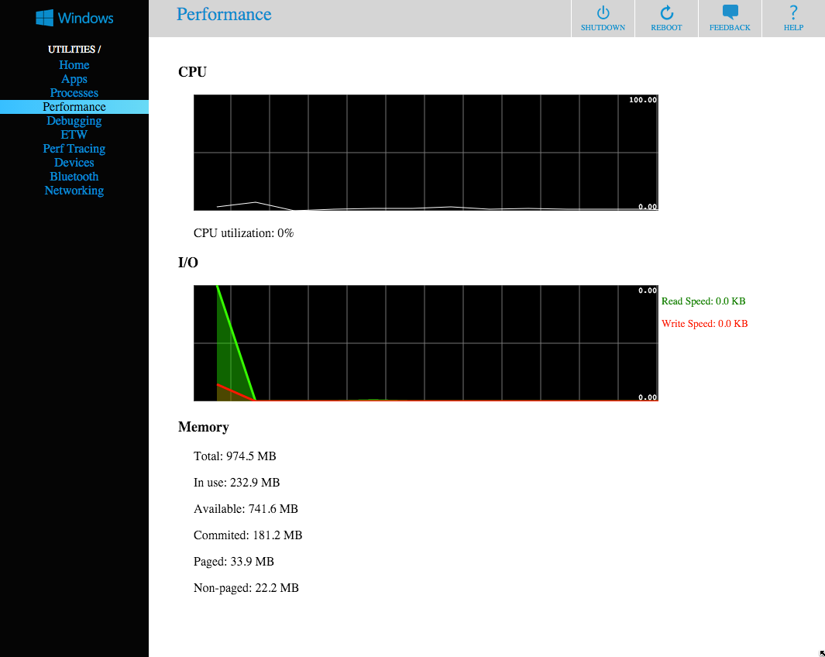
Admin page
Device-ip:8080

Slide 14
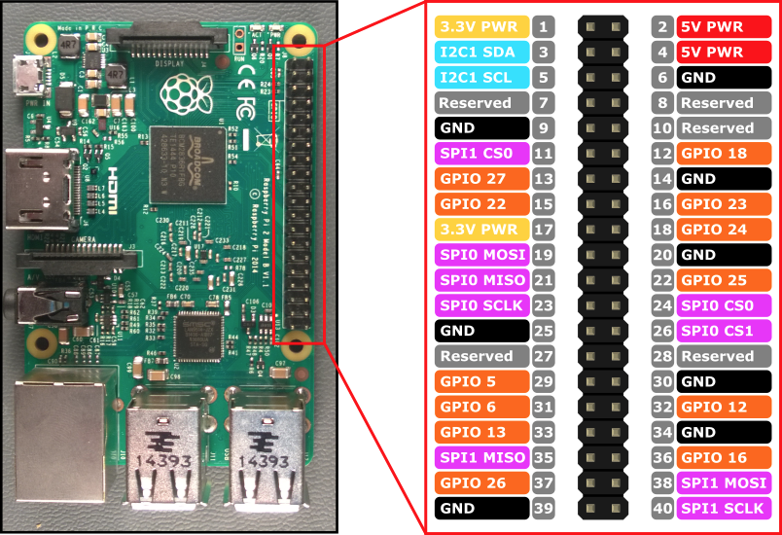
RPI Pins
GPIO
SPIO
I2C

Slide 15
Apps we will build
Blinky
RGB
I2c display matrix
Remote Arduino Leds
Watch to Device

Slide 16
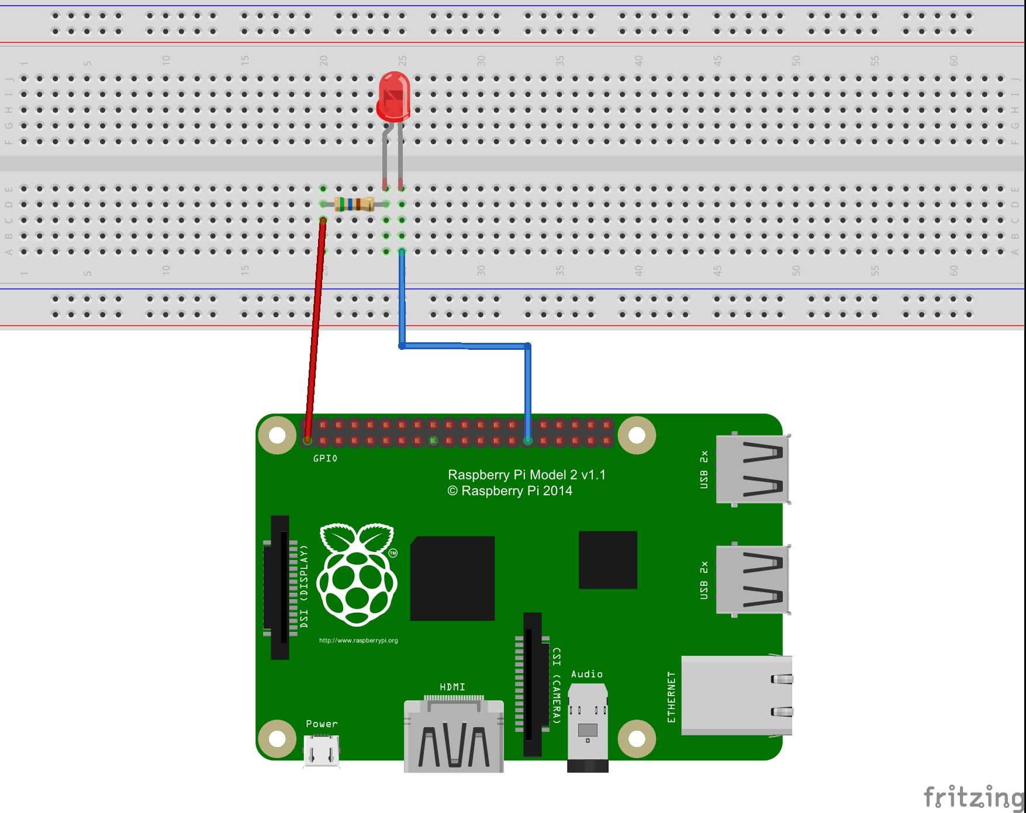
BLinky
Periodically blink an led

Slide 17
Blinky: general steps
Create uwp app
Add IoT extensions
Initialize the GPIO Pins
Blink!

Slide 18
About gpio’s
Can be configured for read or write
Value is high or low
Access through GpioController class

